Slide 1
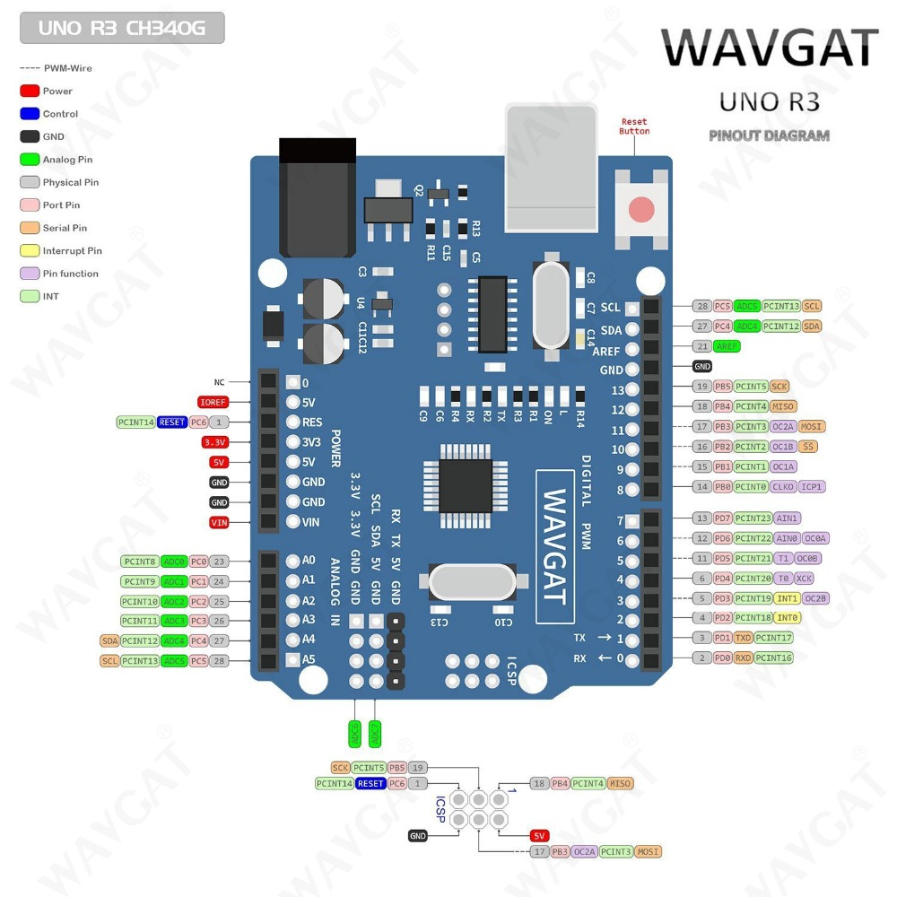

Slide 2
MASTER
SLAVE

Slide 3
SLAVE 2
MASTER
SLAVE 1

